Slide 1

Hackathon:- Code Fury 2024
Automated Meeting Room Booking System
Team Members:
Anjali Tyagi
Arya Pratap Singh
Ishaan Gupta
Shaurya Gularia
Shraddha Jaggi
Sunidhi Suri
Tushar Singh Anand
Photo by Pexels

Slide 2
Table of Contents
01
Introduction
02
Why Automated Meeting Room
03
Features
04
User Experience Focus
05
Future Enhancements

Slide 3
1
Introduction
An automated meeting room system is a digital solution that streamlines the process of scheduling, managing, and utilizing meeting rooms within an organization. It typically includes features such as online booking, real-time availability updates, and integration with other calendar systems. This system allows users to search for and reserve rooms based on various criteria like seating capacity and amenities, and it automates tasks like booking confirmations and room status updates. By automating these processes, the system enhances efficiency, reduces errors, and provides better visibility and management of meeting spaces.
Photo by Pexels

Slide 4
2
Why Automate Meeting Room
Automating the meeting room booking process enhances efficiency and accuracy by streamlining scheduling, reducing manual errors, and improving resource management. It offers a user-friendly interface for convenient booking, ensures optimal room utilization, and provides valuable data insights for informed decision-making. Additionally, automation reduces administrative overhead, ensures consistency across the organization, and enhances security by controlling access. Overall, it simplifies the process, saving time and cost while improving the overall user experience.
Photo by Pexels

Slide 5
3
Features
Business Logic and Database Integration
Develop robust business logic, Data Access Object (DAO) patterns, and an efficient database schema.
Implement a layered architecture to ensure loose coupling and scalability.
MVC Design Pattern
Adhere to the Model-View-Controller (MVC) design pattern for clear separation of concerns and maintainability.
Exception Handling
Implement comprehensive exception handling to manage and respond to errors effectively.
Input Validation
Validate all user inputs thoroughly with appropriate error handling to ensure data integrity and security.
Consistent User Interface
Design a user interface with a consistent layout including a header, footer, and sidebar (navigation links) maintained across all pages.
Prioritize understanding UI design principles before coding.
Optional Enhancements
Explore and integrate various CSS frameworks to create an elegant and responsive UI.
Investigate logging frameworks to allow flexible switching between different logging solutions.
Photo by Pexels

Slide 6
4
Authorization and Security
Ensure unauthorized users do not have access to the system.
Record logs for all unhandled exceptions to monitor and troubleshoot issues.
Home Page
Provide a landing page with navigation to room details and user login options.
Import Users
Implement functionality to import users from an internal XML file with fields including Name, Email, Phone, and Role (Admin/Manager/Member).
Login Functionality
Allow users to log in as Admin, Manager, or Member with appropriate access controls.
Admin Features
Create Room: Interface for creating meeting rooms with amenities and seating capacity details.
Edit Room: Functionality to update meeting room information.
Manager Features
Organize Meeting: Interface for booking and organizing meetings, with credit deduction upon room booking.
Update Credits: Automated task to reset project managers' credits to 2000 every Monday morning at 6 AM.
Member Features
View Meeting Schedule: Display meeting schedules specific to the member's login
Photo by Pexels

Slide 7
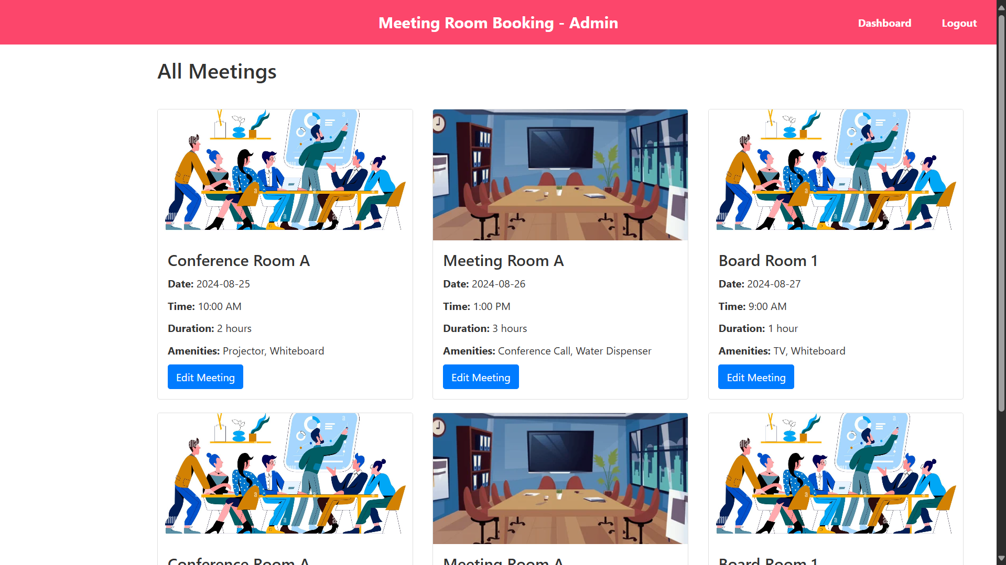

Slide 8
5
Tools
For the Automated Meeting Room project, I utilized JavaScript, HTML, and CSS for front-end development, creating a dynamic and responsive user interface. On the back end, I employed Java and MySQL for robust server-side processing and data management. Additionally, I used Maven for project management and IntelliJ IDEA as the integrated development environment (IDE) to streamline development and enhance productivity.
Photo by Pexels

Slide 9
UI SnapShots

Slide 10
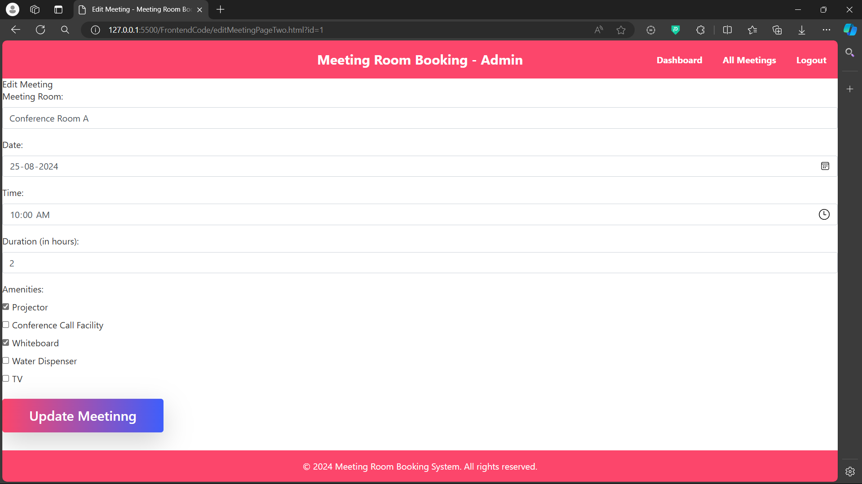

Slide 11
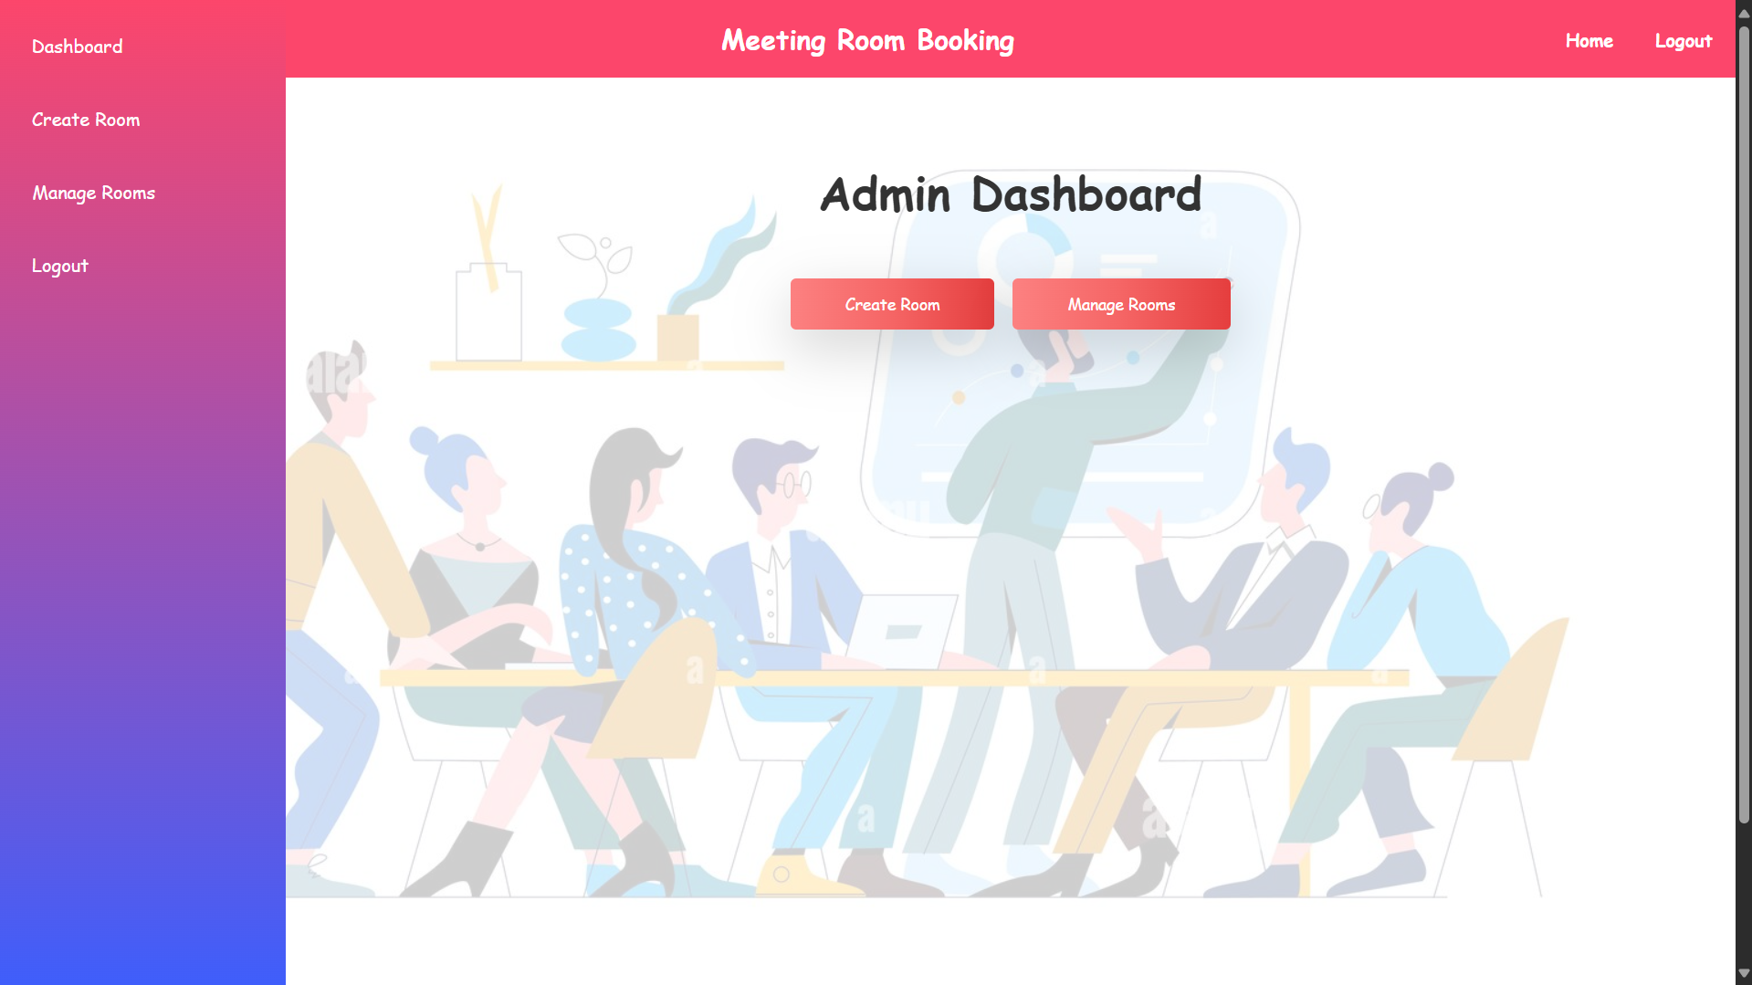

Slide 12
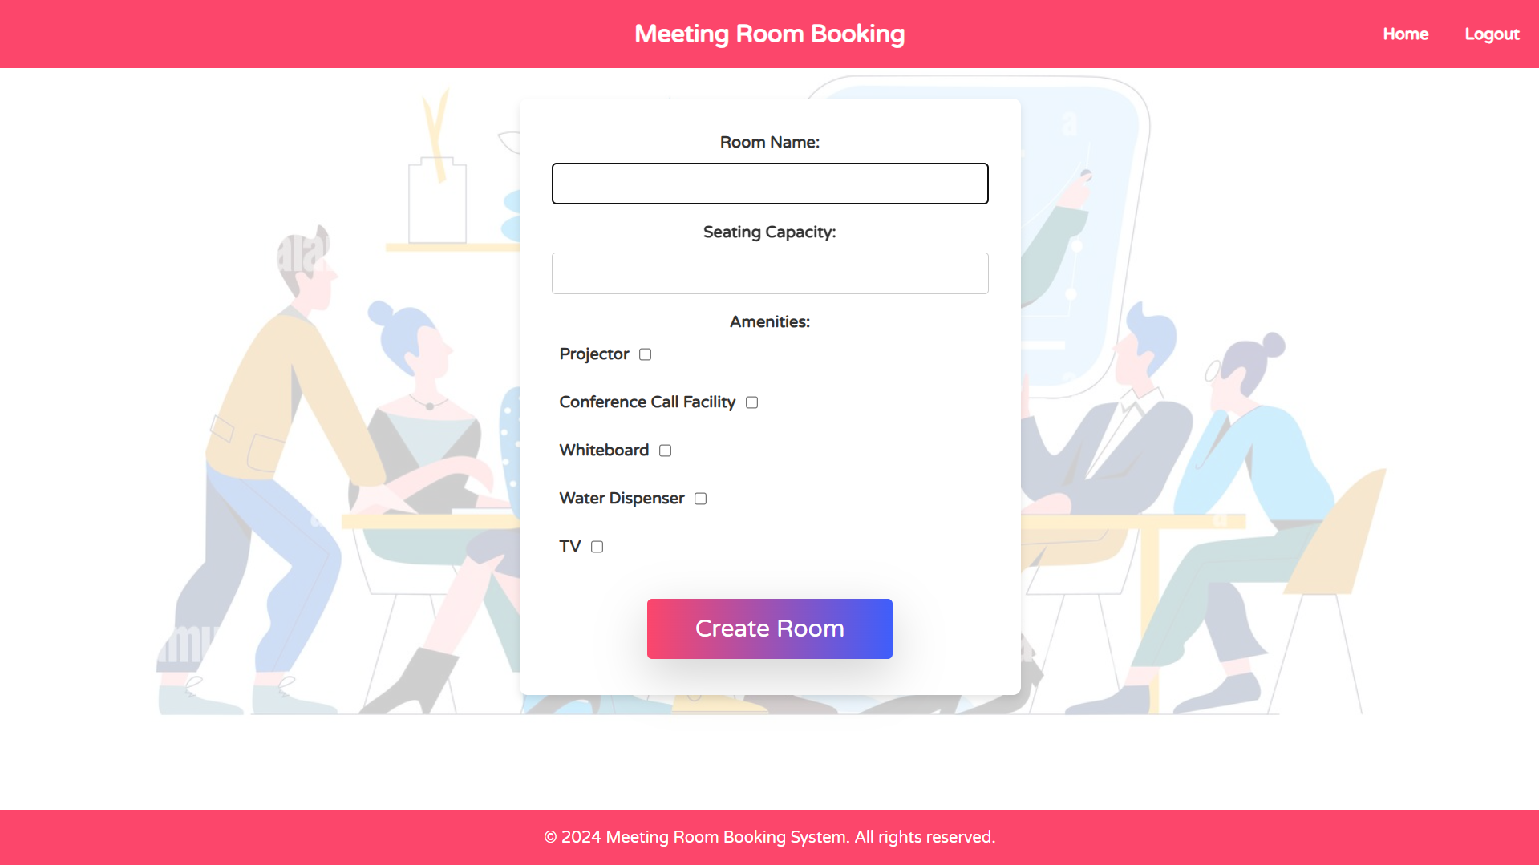

Slide 13
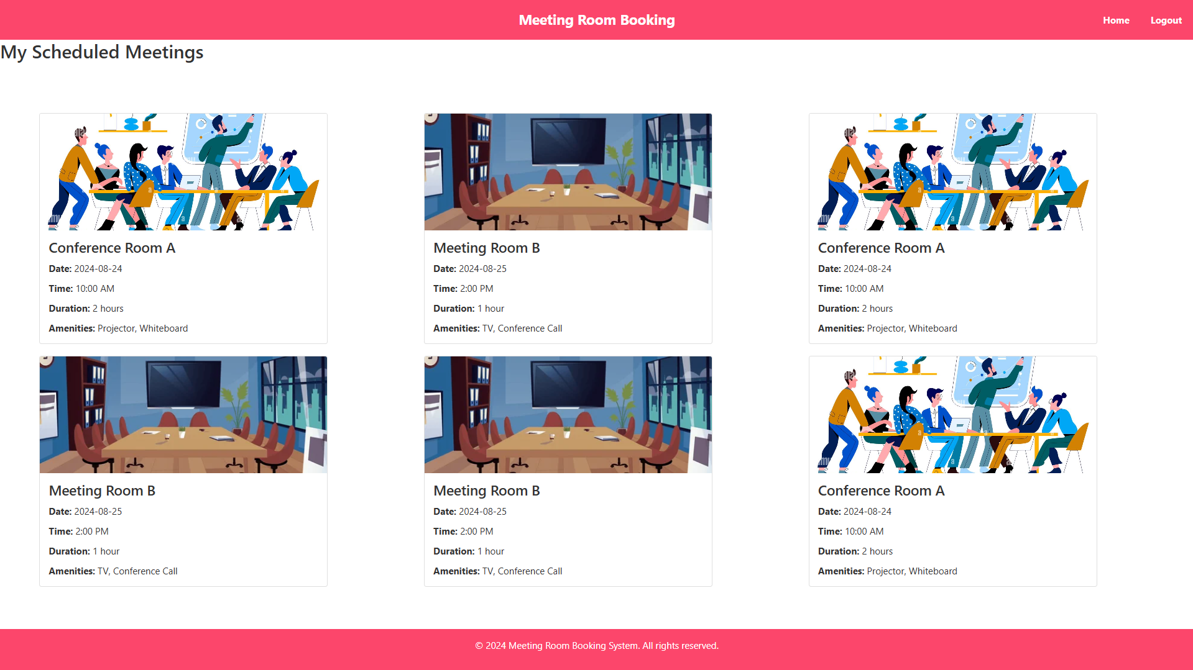

Slide 14
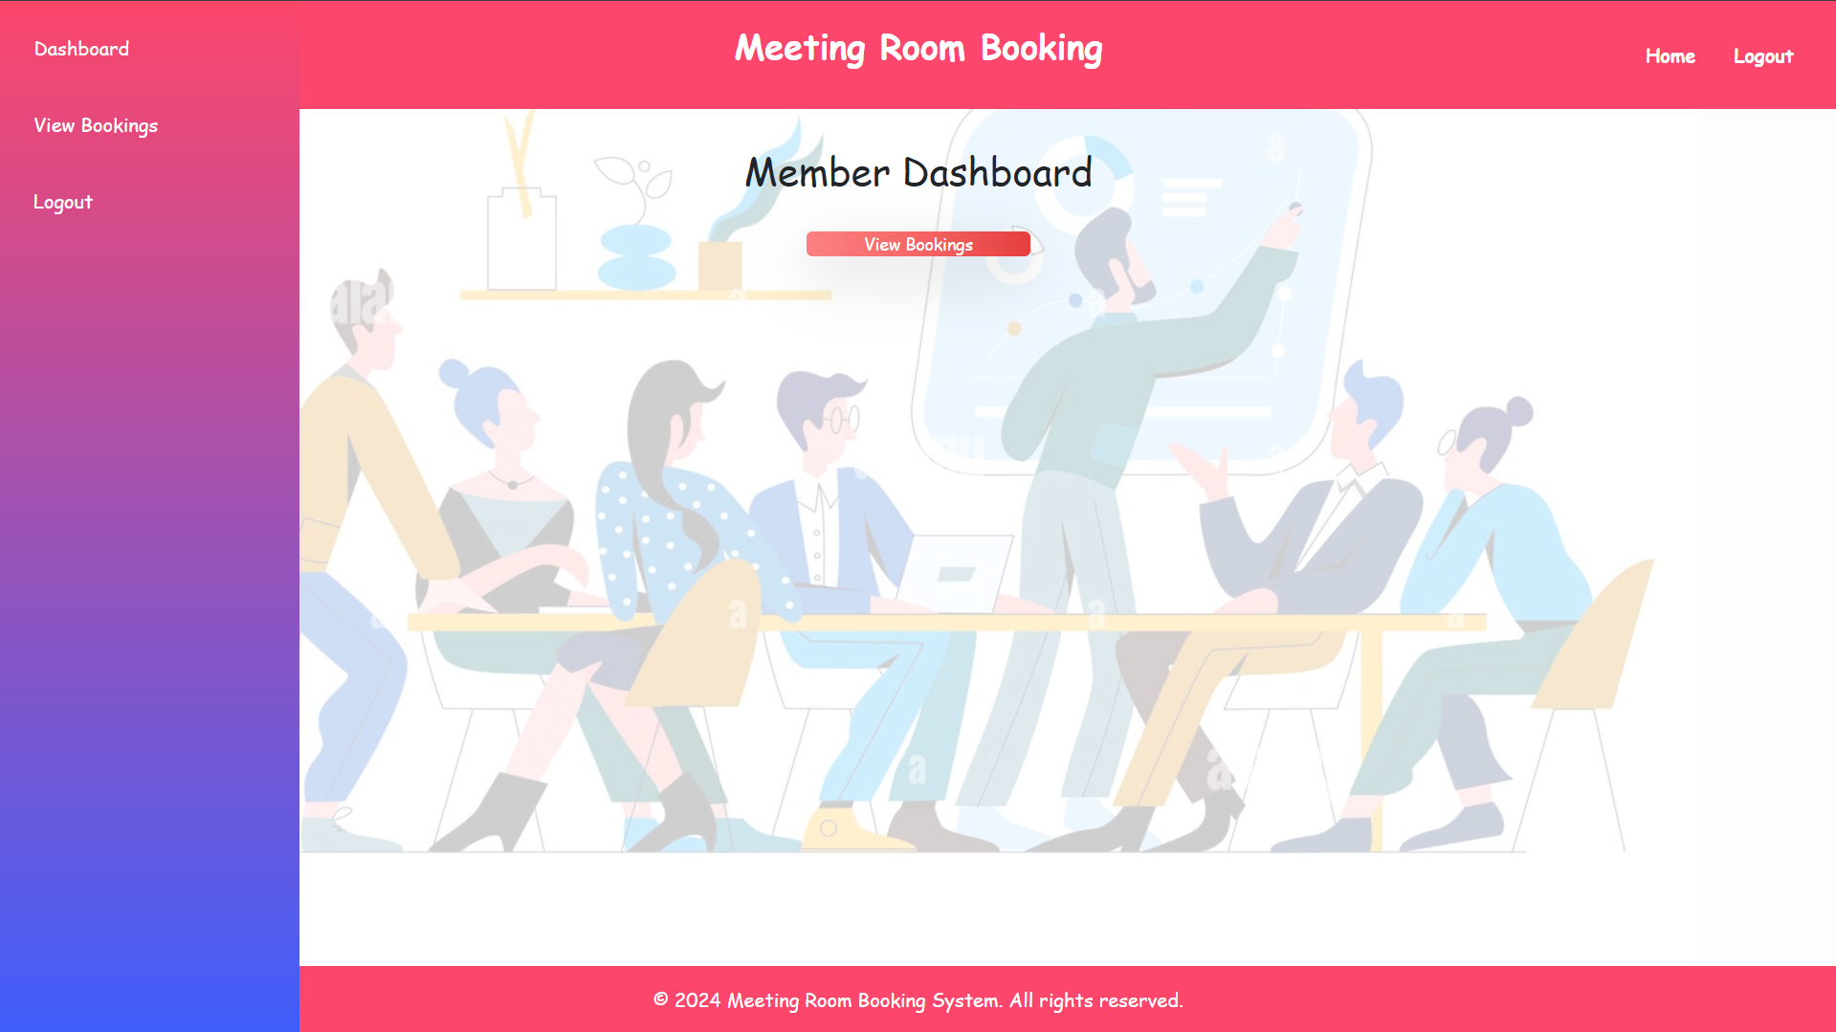

Slide 15
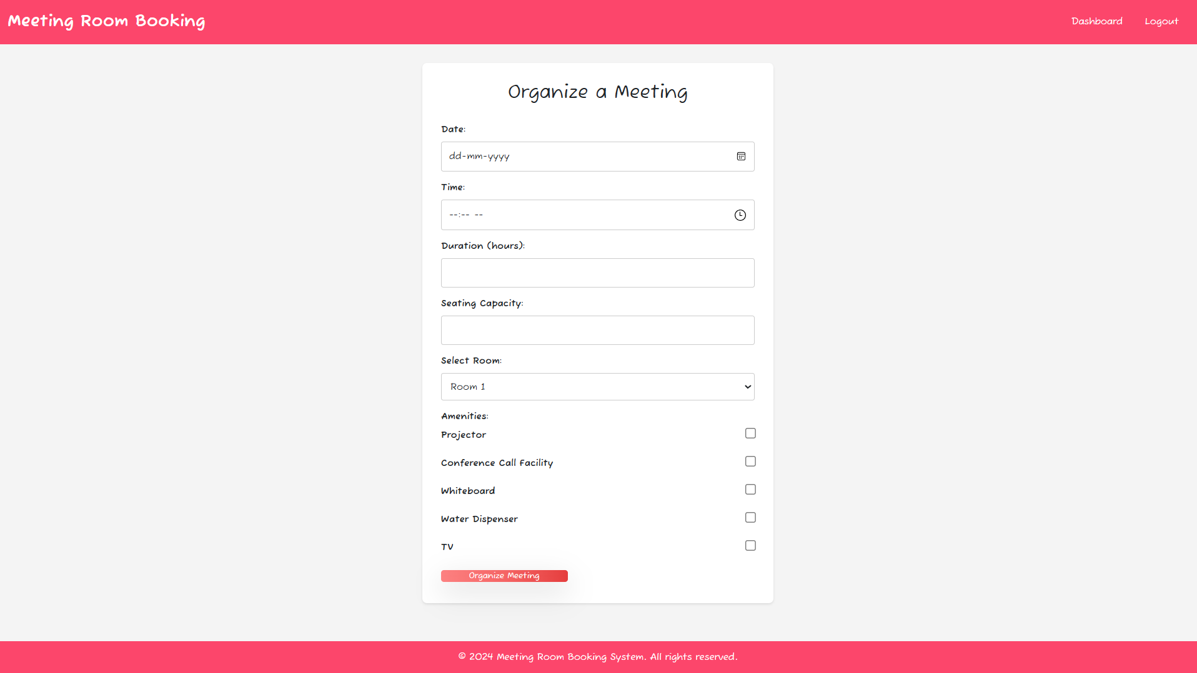

Slide 16
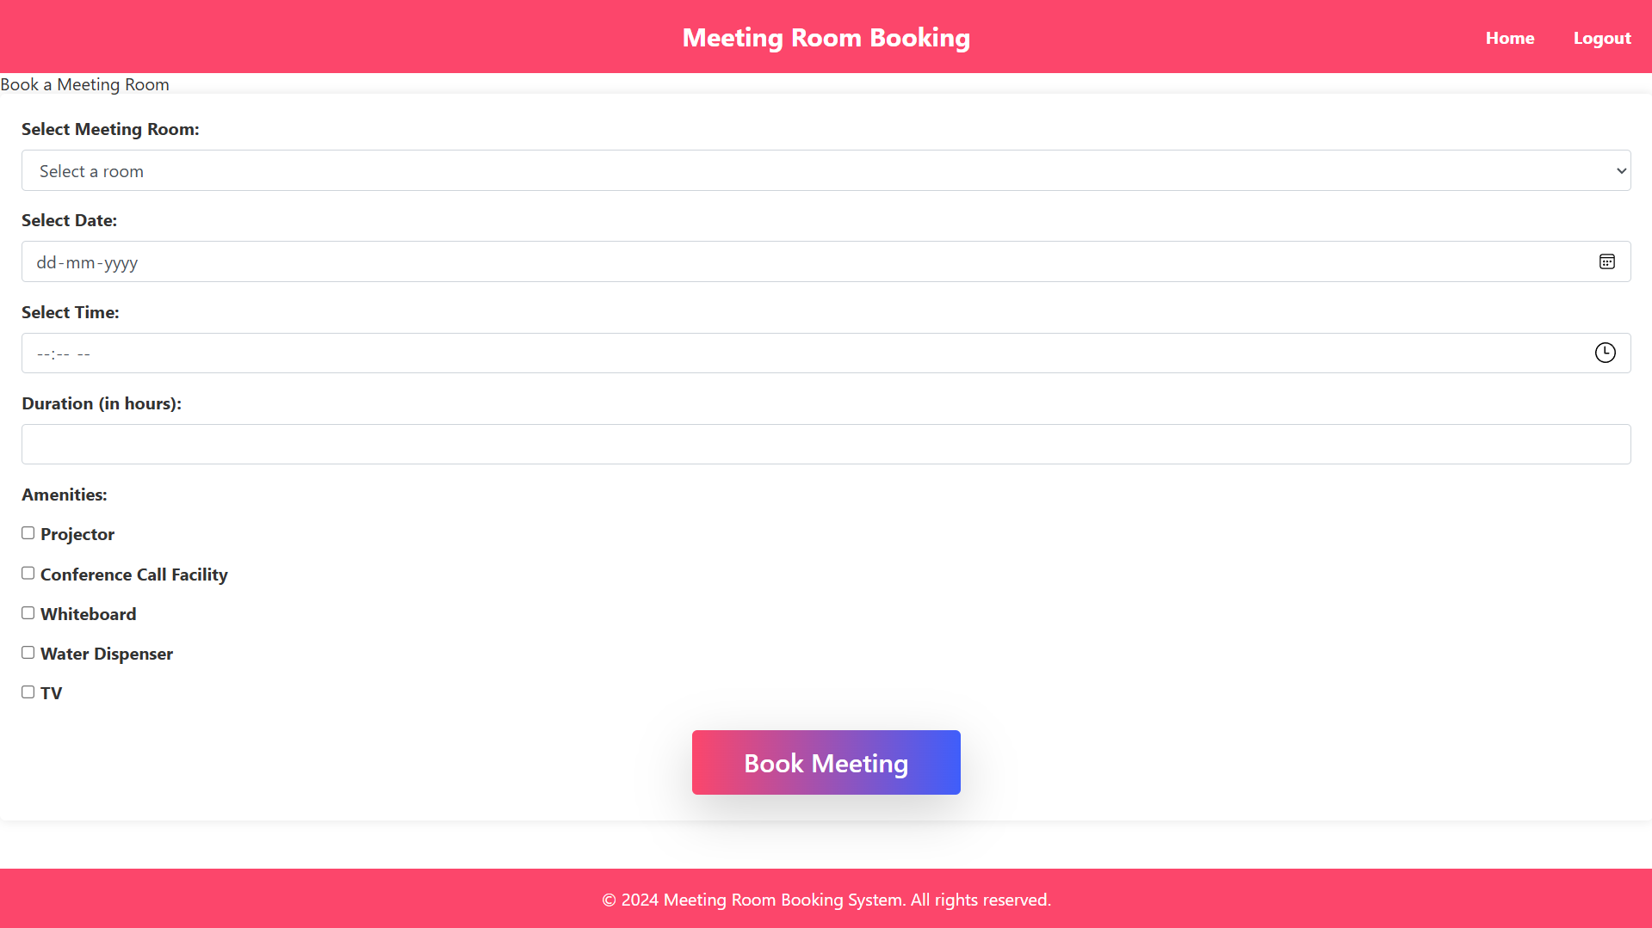

Slide 17
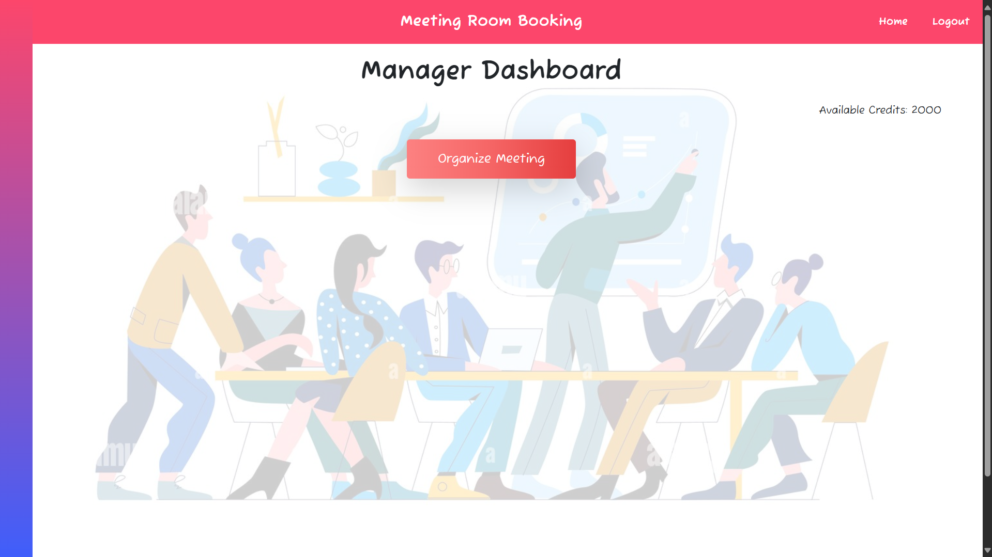

Slide 18
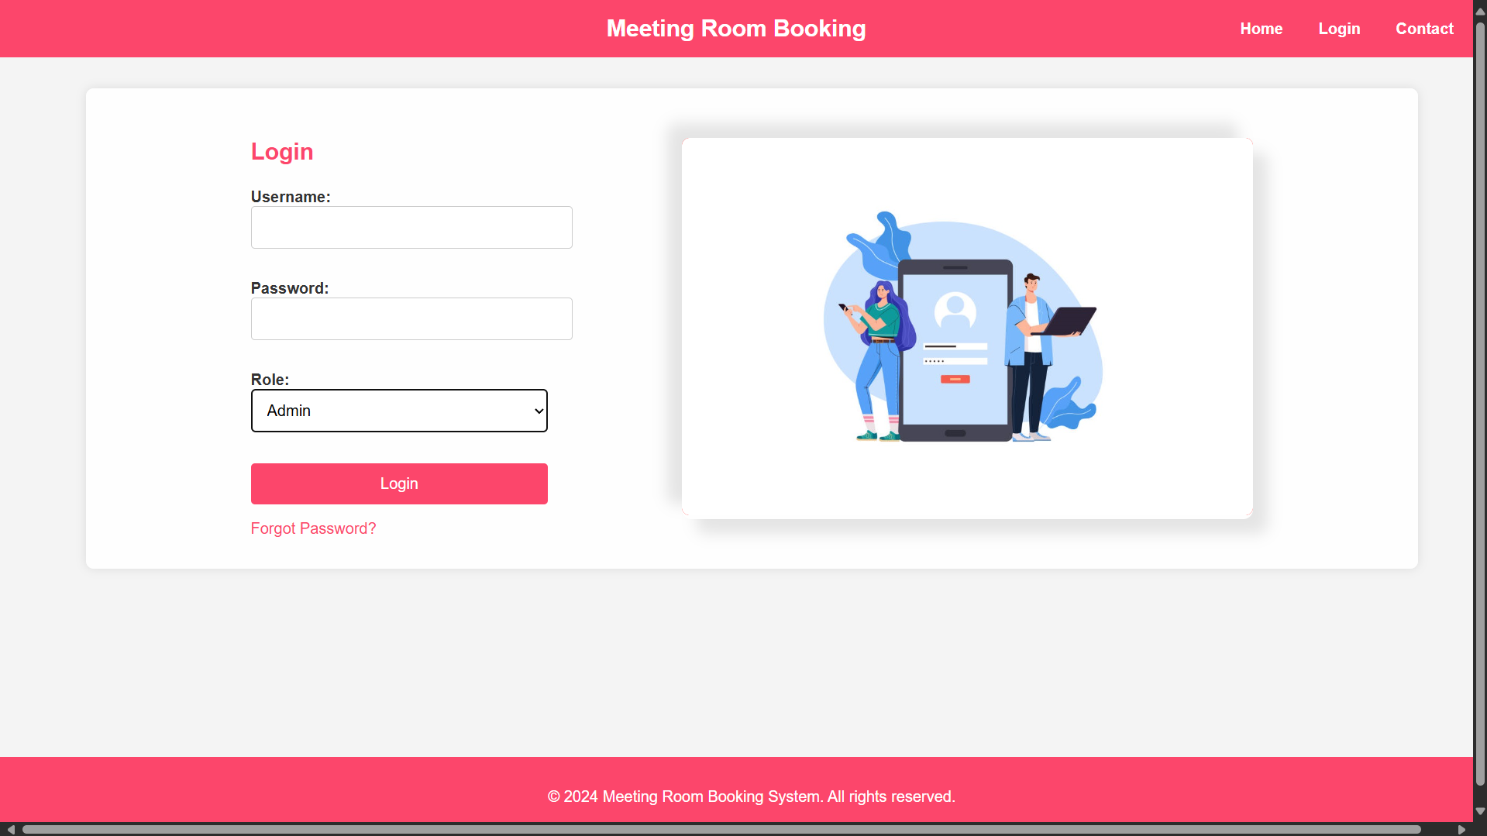

Slide 19
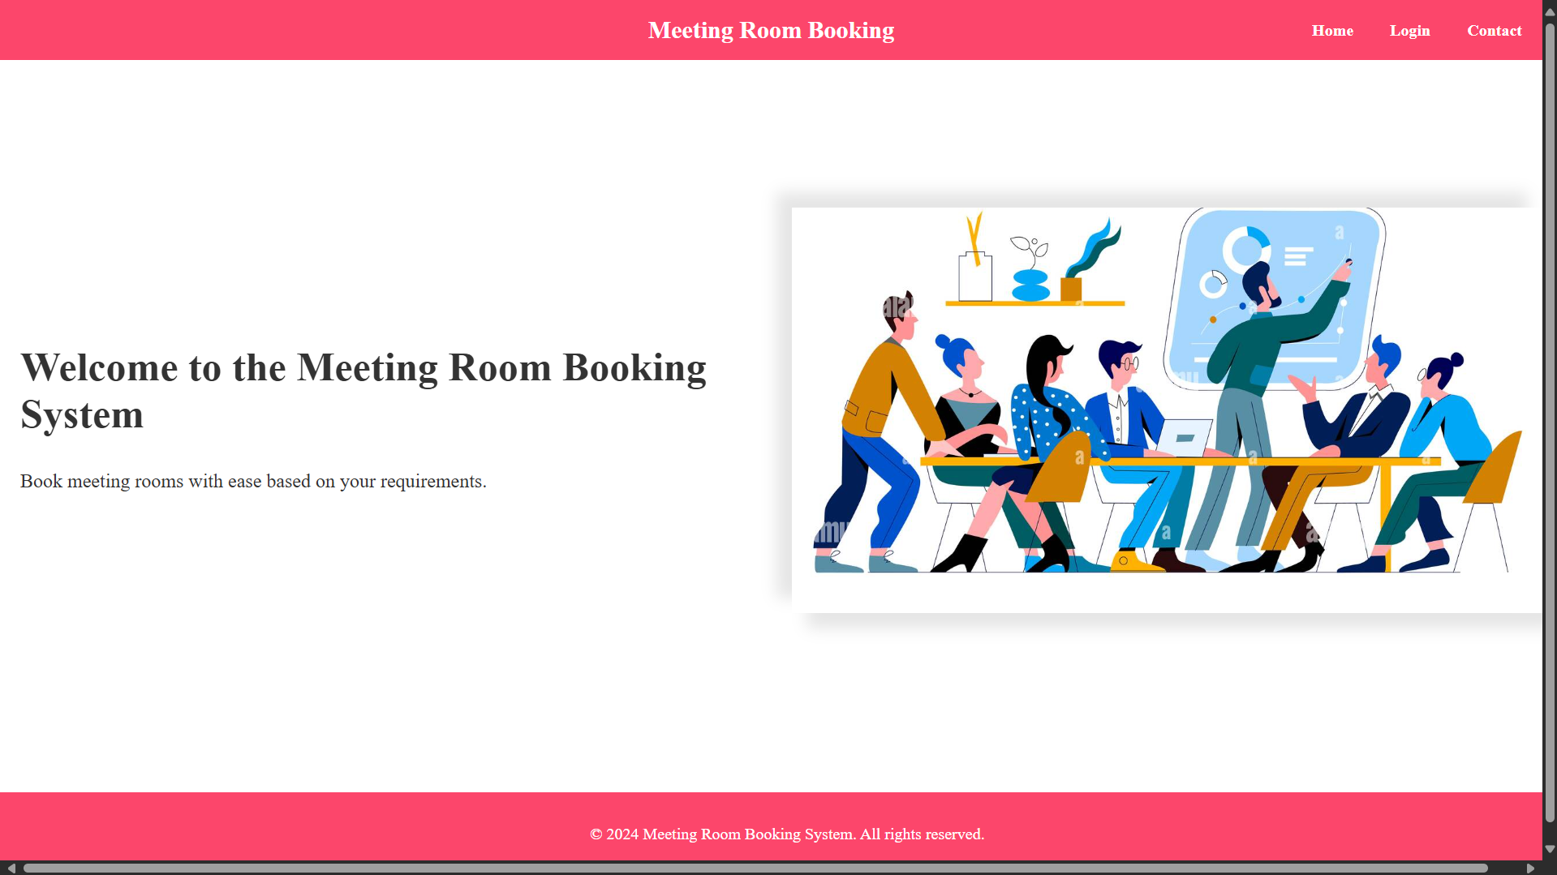

Slide 20
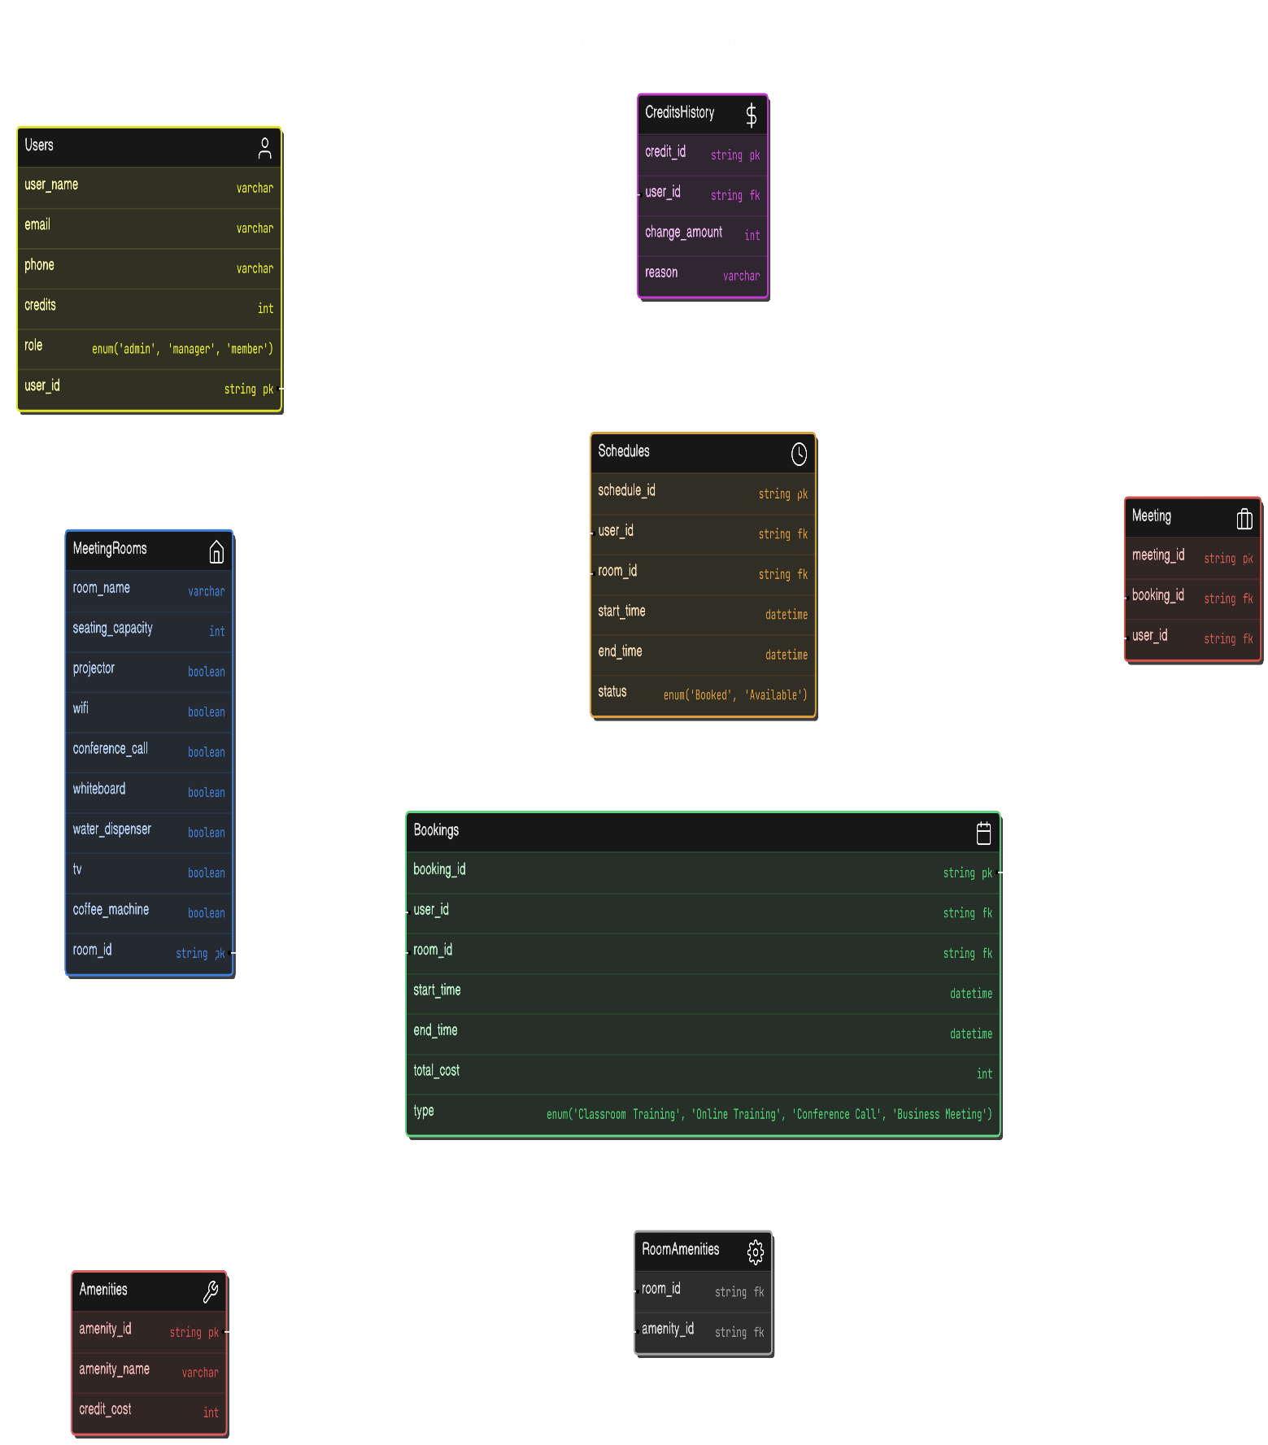
ER
Diagram

